Slide 1

Riverside Patient Group

Slide 2
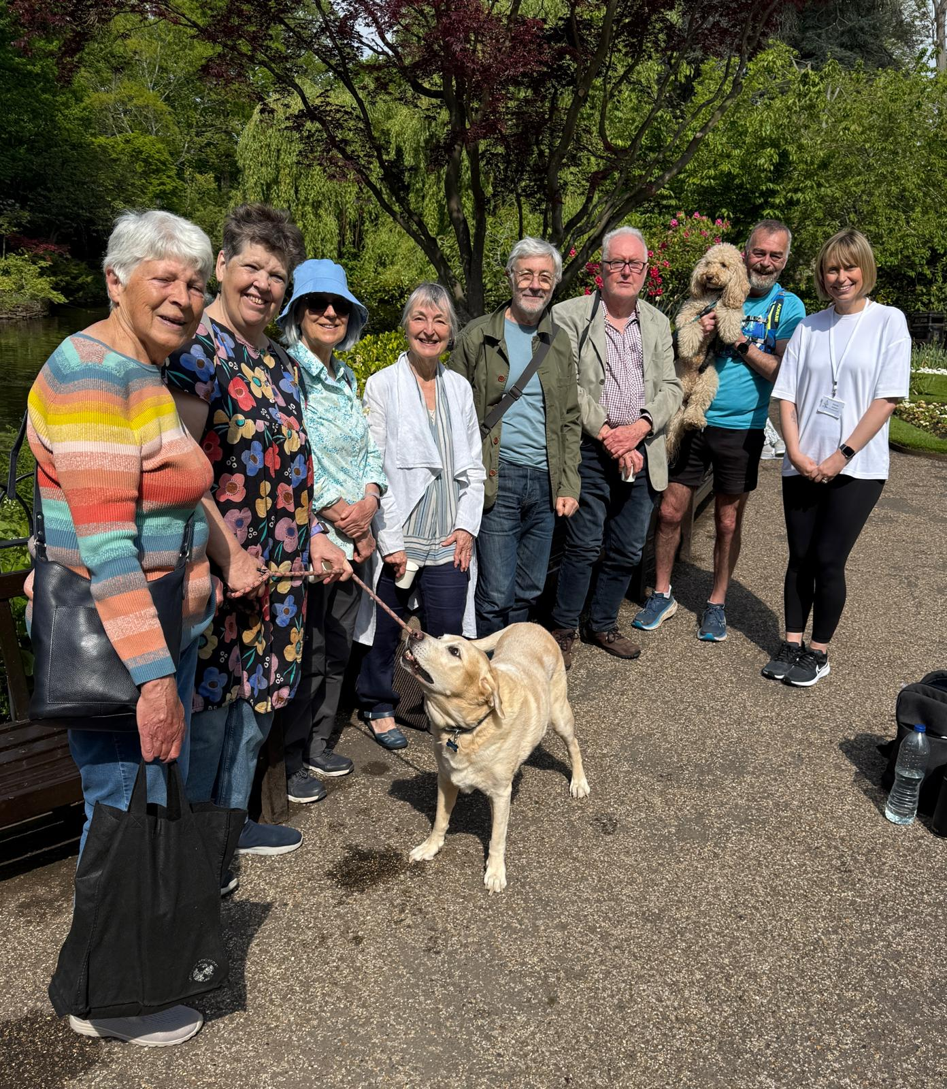
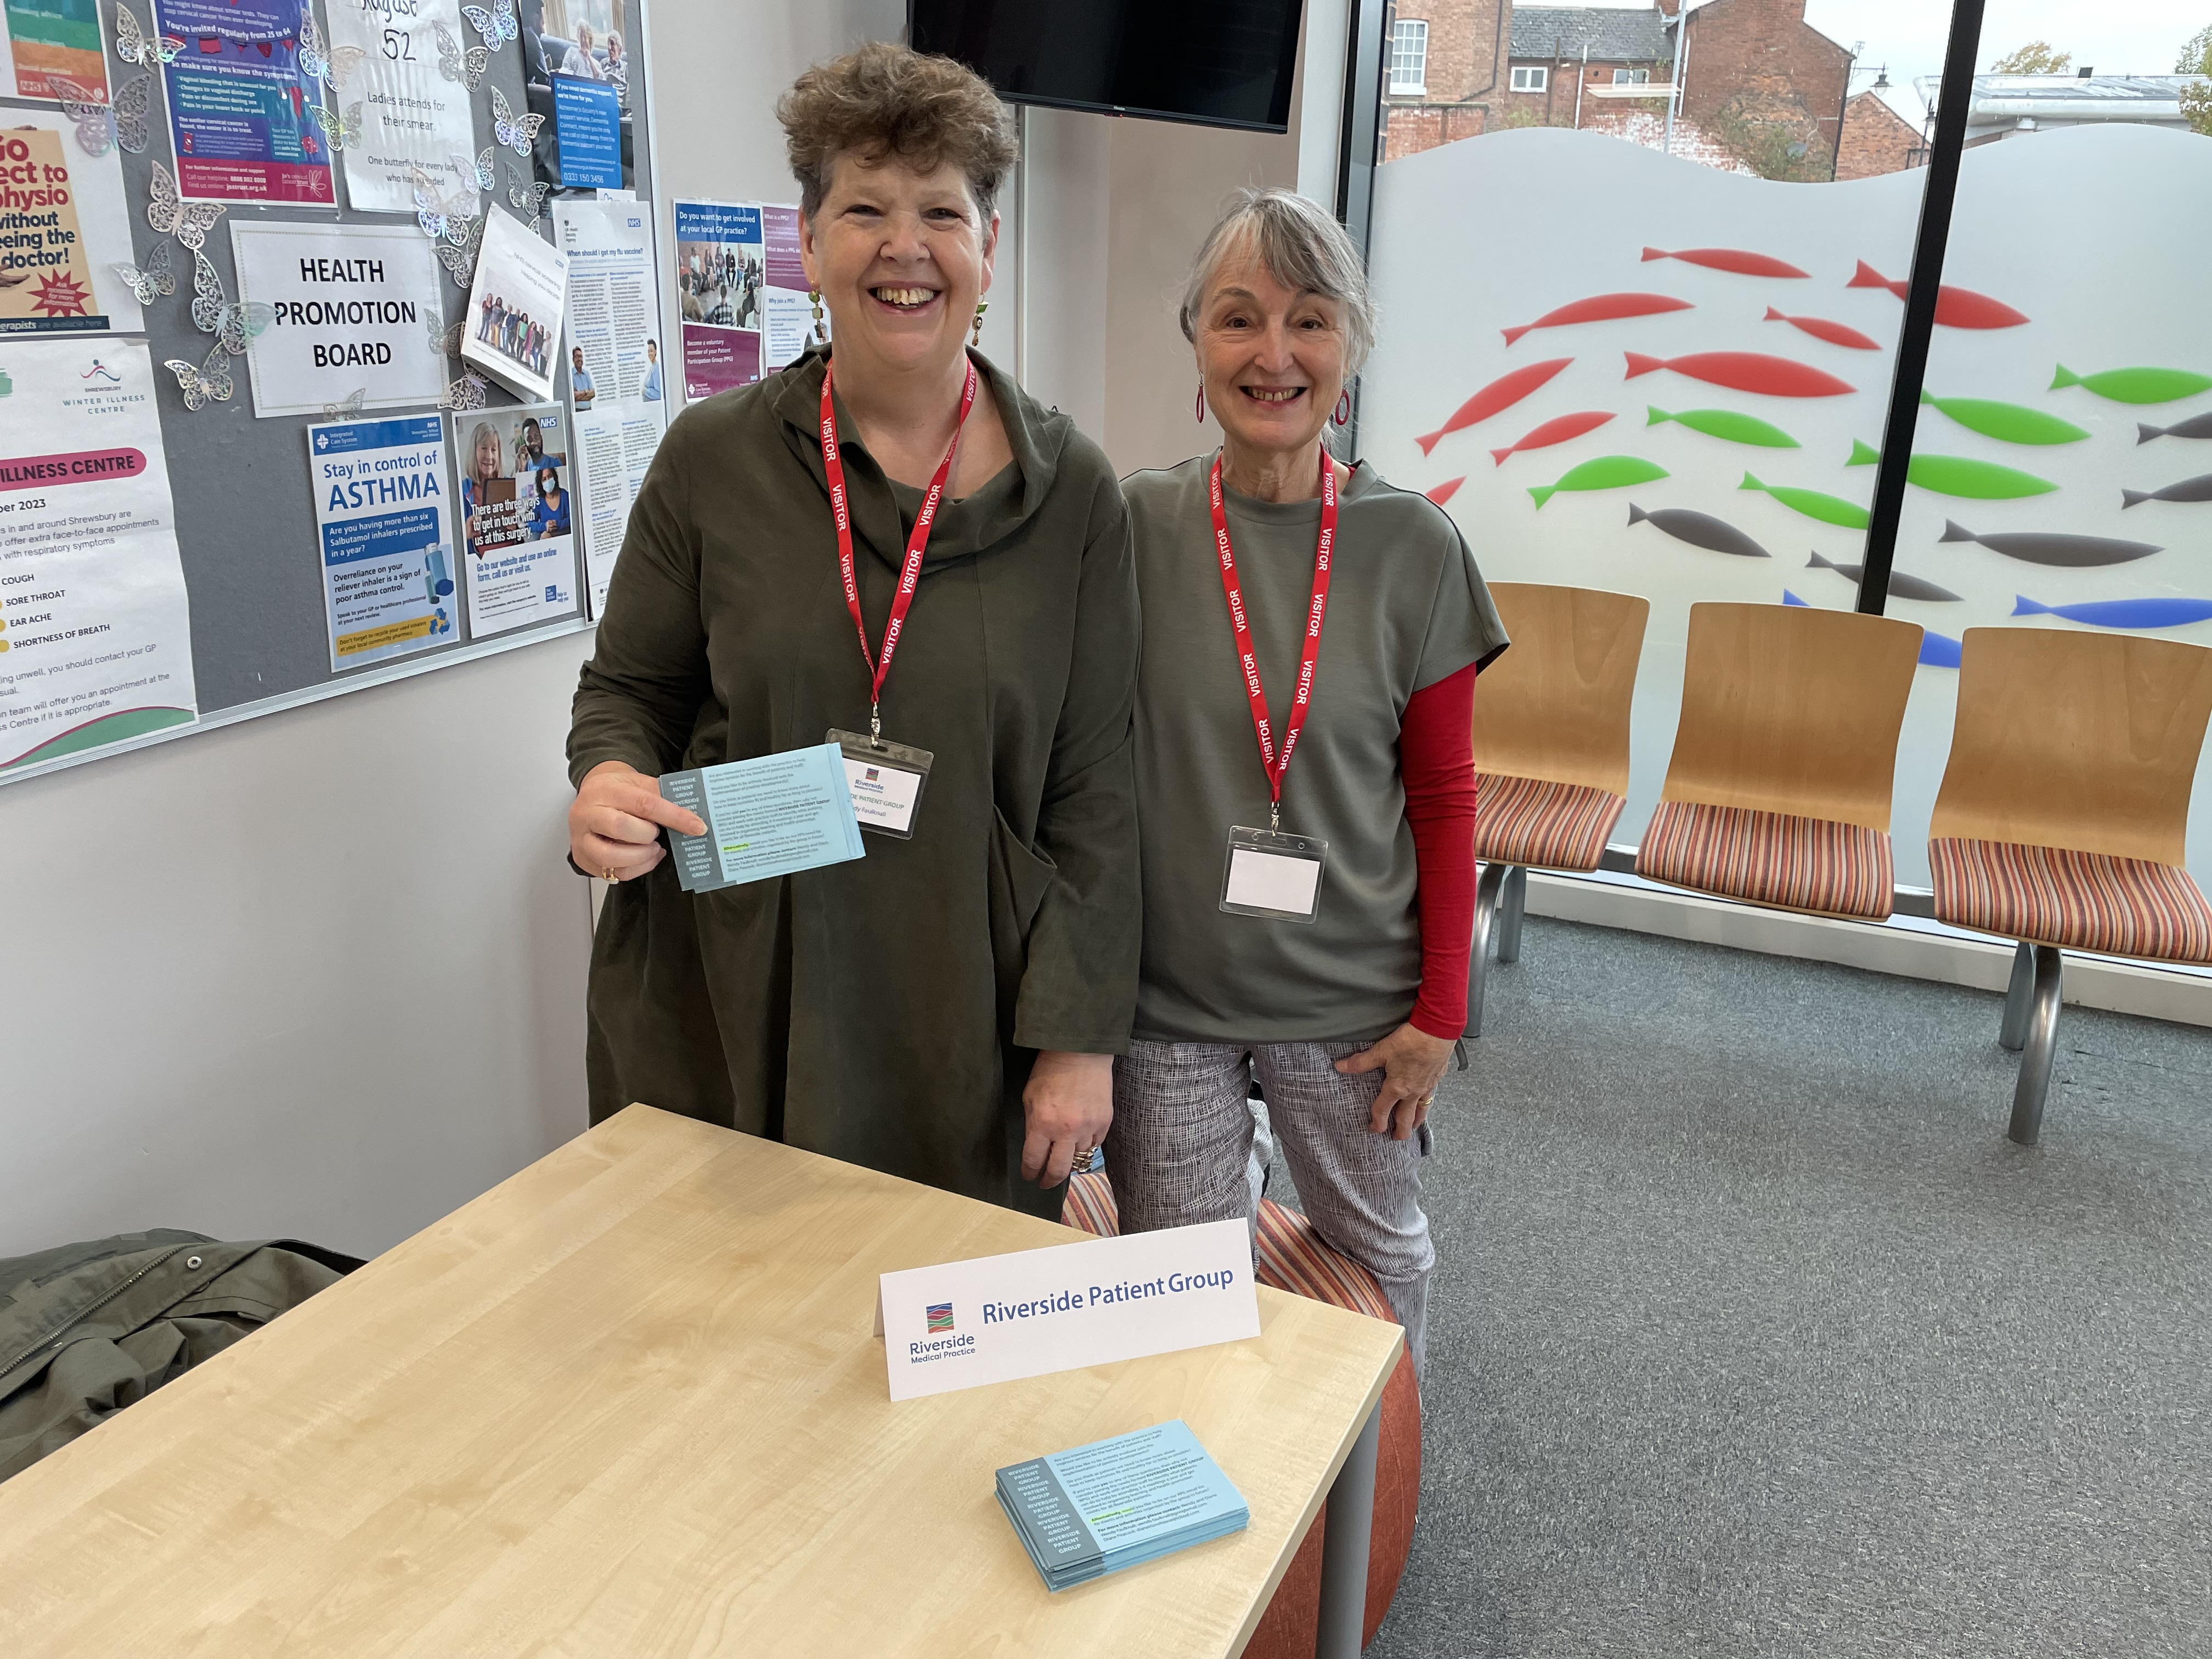
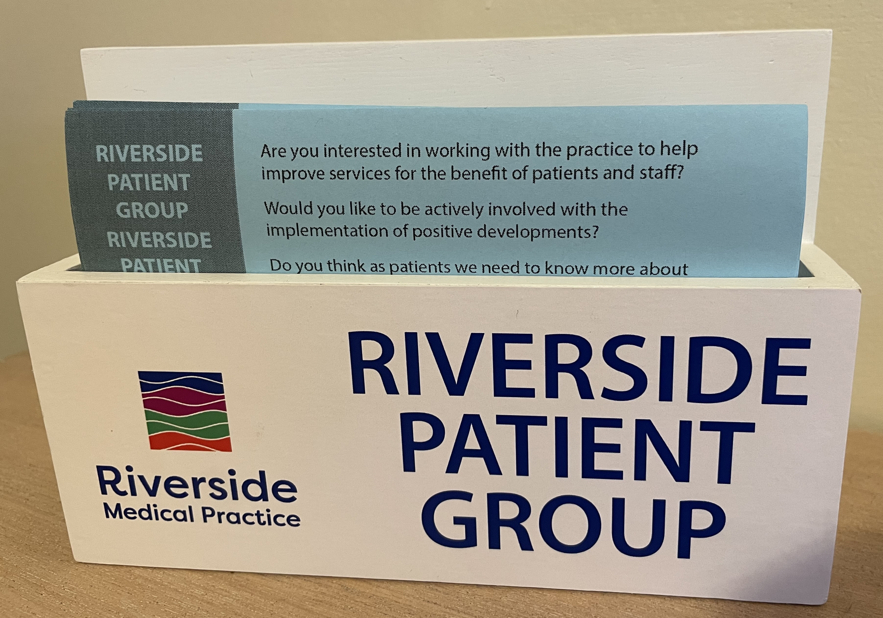
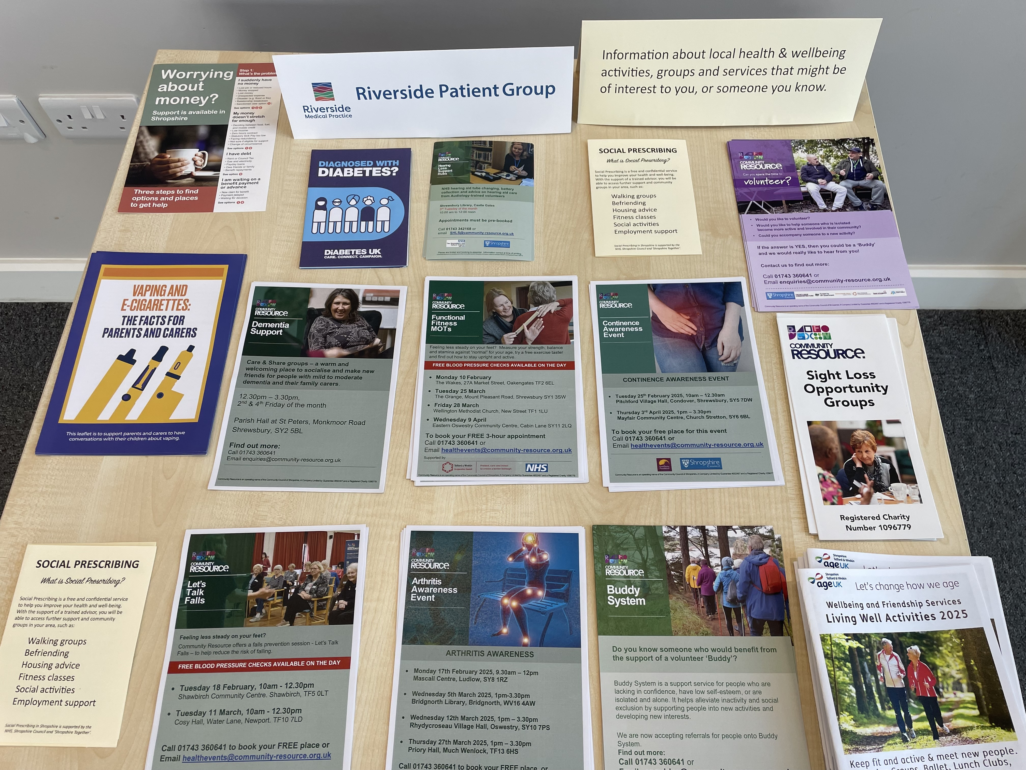
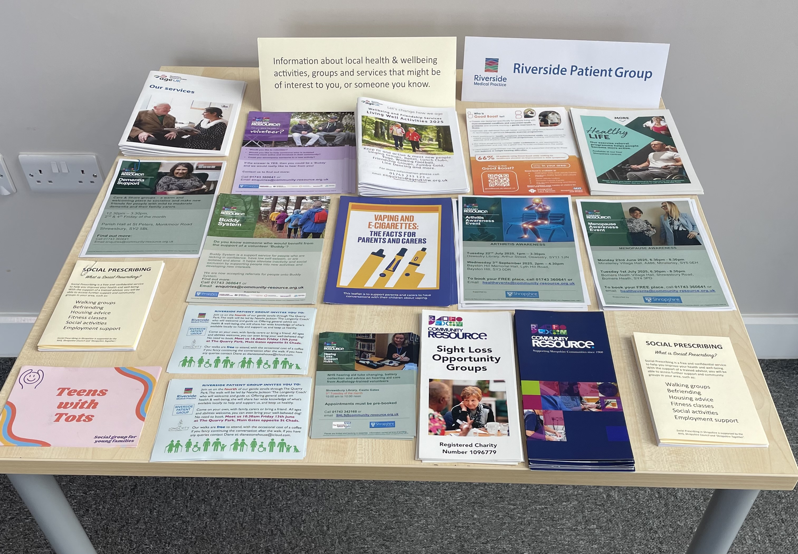
Riverside Patient Group

Slide 3
What are we trying to do?
Work with the practice to improve patients understanding as to what is available at their GP Practice
Work with the practice to promote initiatives for the benefit of patients
Help us all as patients understand how we can improve our health and wellbeing.

Slide 4
How we hope to do this
Provide various opportunities to share your experience as a Riverside patient and/or a carer
Work with practice staff to plan and promote activities and events specifically for Riverside patients
Share information on general health & wellbeing activities in the local area

Slide 5
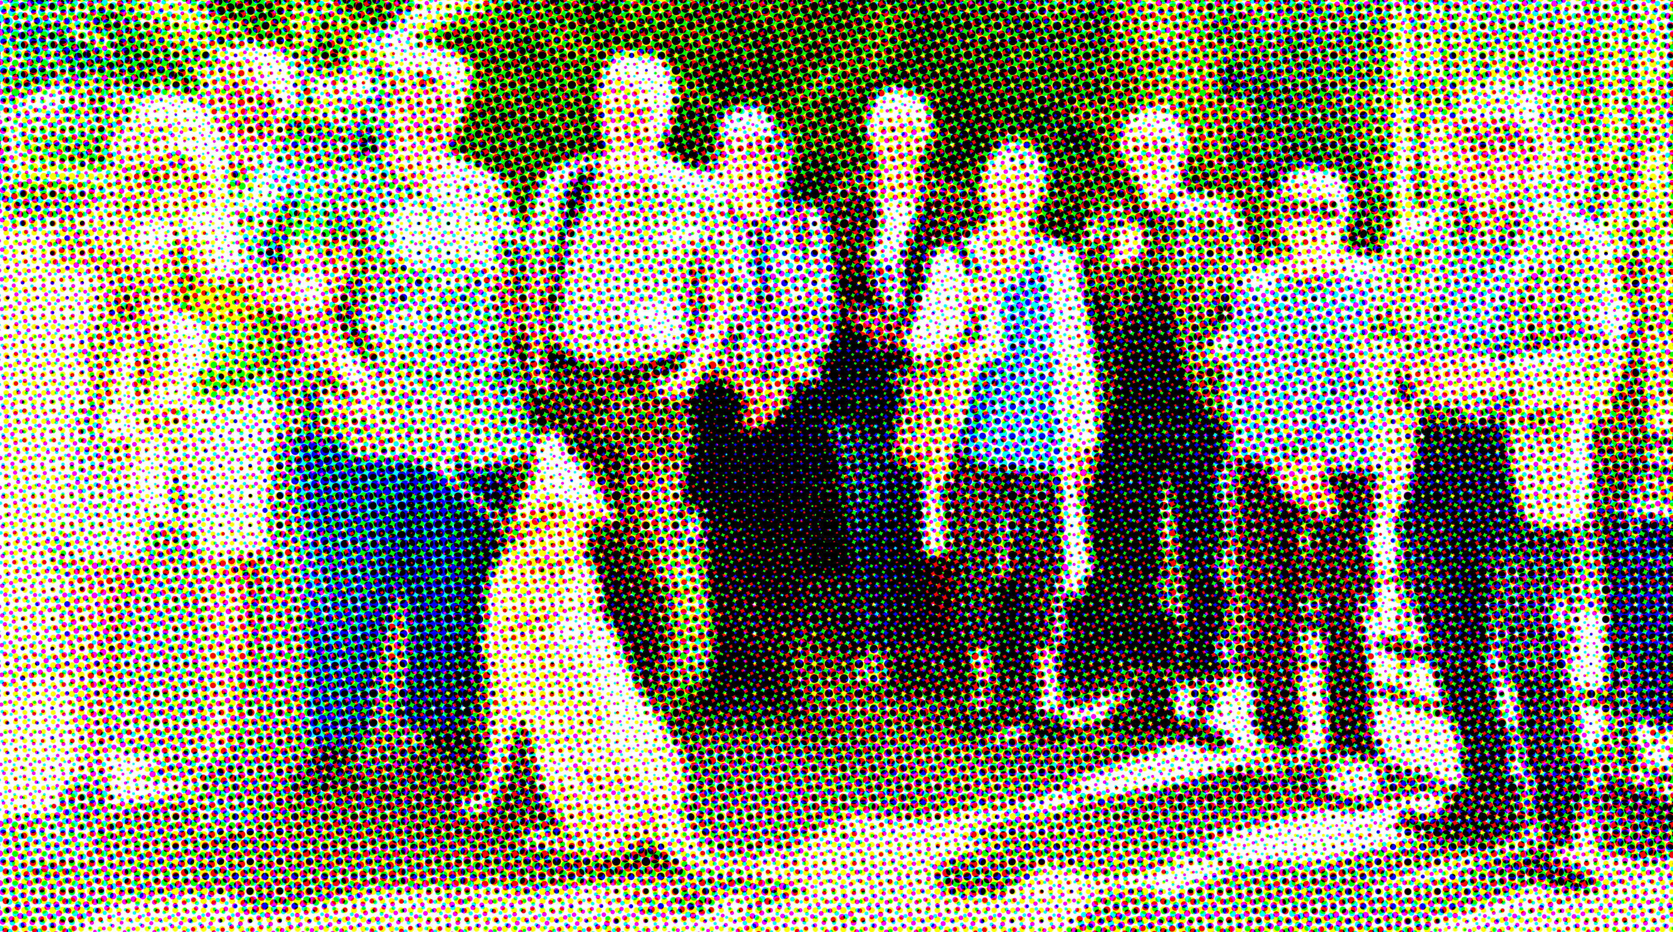
Riverside Patients Walk & Talk 16 May 2025

Slide 6
How can you help?
Join the RPG mailing list if you would like to get regular updates on what we are doing, share your views and meet us informally.
Register as an RPG Volunteer to be invited to help when we host health & wellbeing activities, get-togethers in local cafés or assist with vaccination days.
Offer your skills to the RPG group. At the moment, we are looking for people who could help with with technology, data searches and leaflet & poster design, and would welcome younger members.

Slide 7
There’s a little blue leaflet in each waiting area with the names and contact details for Diane & Wendy our co-chairs. Please email us if you want to
be put on our mailing list or
become a RPG volunteer or share your skills.

Slide 8
If you don’t have access to a mobile phone or computer, please write your name and landline number on the back of a blue leaflet and leave it with the reception staff and Diane or Wendy will contact you.

Slide 9
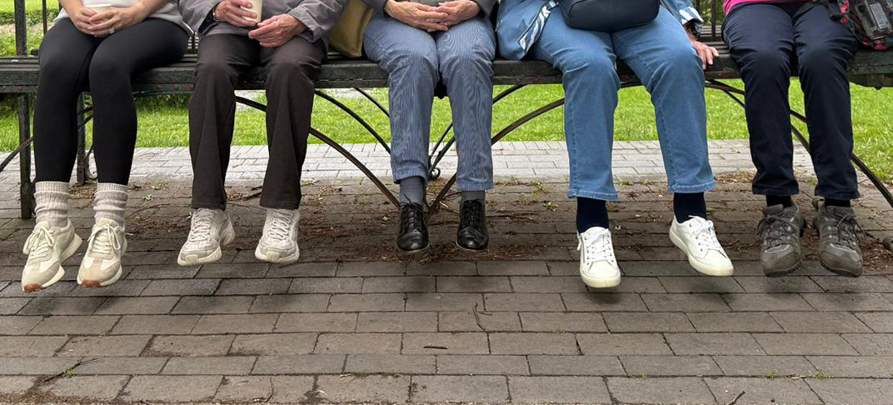
If you read this on the Riverside website or Facebook page and would like to be on our mailing list OR be an RPG volunteer or contribute skills, please contact Diane: dianestonehouse@icloud.com Wendy:wendy.faulknall@googlemail.com

Slide 10

Thank You
For Taking The Time To Read This

